Slide 1
Three levels of government activity

Slide 2
Instructions for teachers
This activity provides students the opportunity to consider the roles and responsibilities of the three levels of Australia’s government.
Students will read the ‘How to Play’ instructions on slide 4 and then on slide 5 (in edit mode, not slide show mode) drag and drop responsibilities to the level they choose.
You may want to give students only slides 4 and 5 to work on individually or in groups.
Slide 3 has the answers including the two that are joint responsibility of both federal and state/territory governments.
This could lead to discussions around their thoughts and opinions of these allocations including complexities that may arise.
ACT DISCLAIMER: Functions of local government in the ACT are the responsibility of the ACT Territory Government.

Slide 3





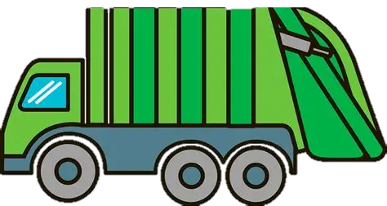








Answers
Federal
State/ Territory
Local
_{Foreign Affairs}
_{Driving licenses}
_{Libraries}
_{Defence}
_{Prisons}
_{Rubbish collection}
_{Aviation}
_{Public transport}
_{Pets}
_{P}
_{Currency}
_{Police/ambulance}
_{Parking}
Joint responsibility
Federal and state
Joint responsibility
State and local
Joint responsibility
All Levels
_{Education}
$
_{Town Planning}
_{Taxation}
_{Healthcare}

Slide 4


How to play
Drag each responsibility card to the correct column: Federal, State/Territory, or Local.
Some responsibilities may overlap—be prepared to justify your choices!
Use the next slide to sort and check your answers at the end.
_{Example item}
Level of government
◆ Example animation

Slide 5
Federal
State/ Territory
Local
_{Driving licenses}
_{Libraries}
_{Town Planning}
_{Foreign Affairs}
_{Defence}
_{Aviation}
_{Currency}
_{Rubbish collection}
_{Education}
_{Prisons}
_{Healthcare}
_{Public transport}
_{P}
_{Pets}
$
_{Parking}
_{Police/ambulance}
_{Taxation}

Slide 6
Extra information
ACT: Functions of local government in the ACT are the responsibility of the ACT Territory Government.
Explanations of cross-jurisdictional responsibilities:
 | Federal responsibilities: Setting the curriculum, distributing education funding for primary and secondary schools to States and Territories and regulating tertiary institutions. State/Territory responsibilities: Operating, regulating and distributing funding for primary and secondary schools and issuing qualifications such as Senior Secondary Certificates of Education (HSC, VCE, WACE etc.)
 | Federal responsibilities Running programs such as Medicare, regulation of medication and running the Pharmaceutical Benefits Scheme. State/Territory responsibilities: Operating and managing public hospitals, public dental clinics, ambulance services, food safety and handling, managing community health services.
 | State responsibilities: Overarching and large-scale town planning of cities and large infrastructure projects, establishment of planning and zoning system. Local responsibilities: Some building regulations, building permits, local street and suburb planning.
 | All levels of government collect revenue to enable their operations. Some examples may include: Income tax and GST (Federal), land taxes and stamp duty (State/Territory), rates (Local).
_{Education}
_{Healthcare}
_{Town Planning}
$
_{Taxation}

